Slide 1
Digital Library Platform Use
OverDrive, Freegal, and RBdigital use over time

Slide 2
2018 Circulation Comparison
 | Physical | AV | Digital
2018 | 779221 | 439925 | 211249
 | 54% | 31% | 15%

Slide 3
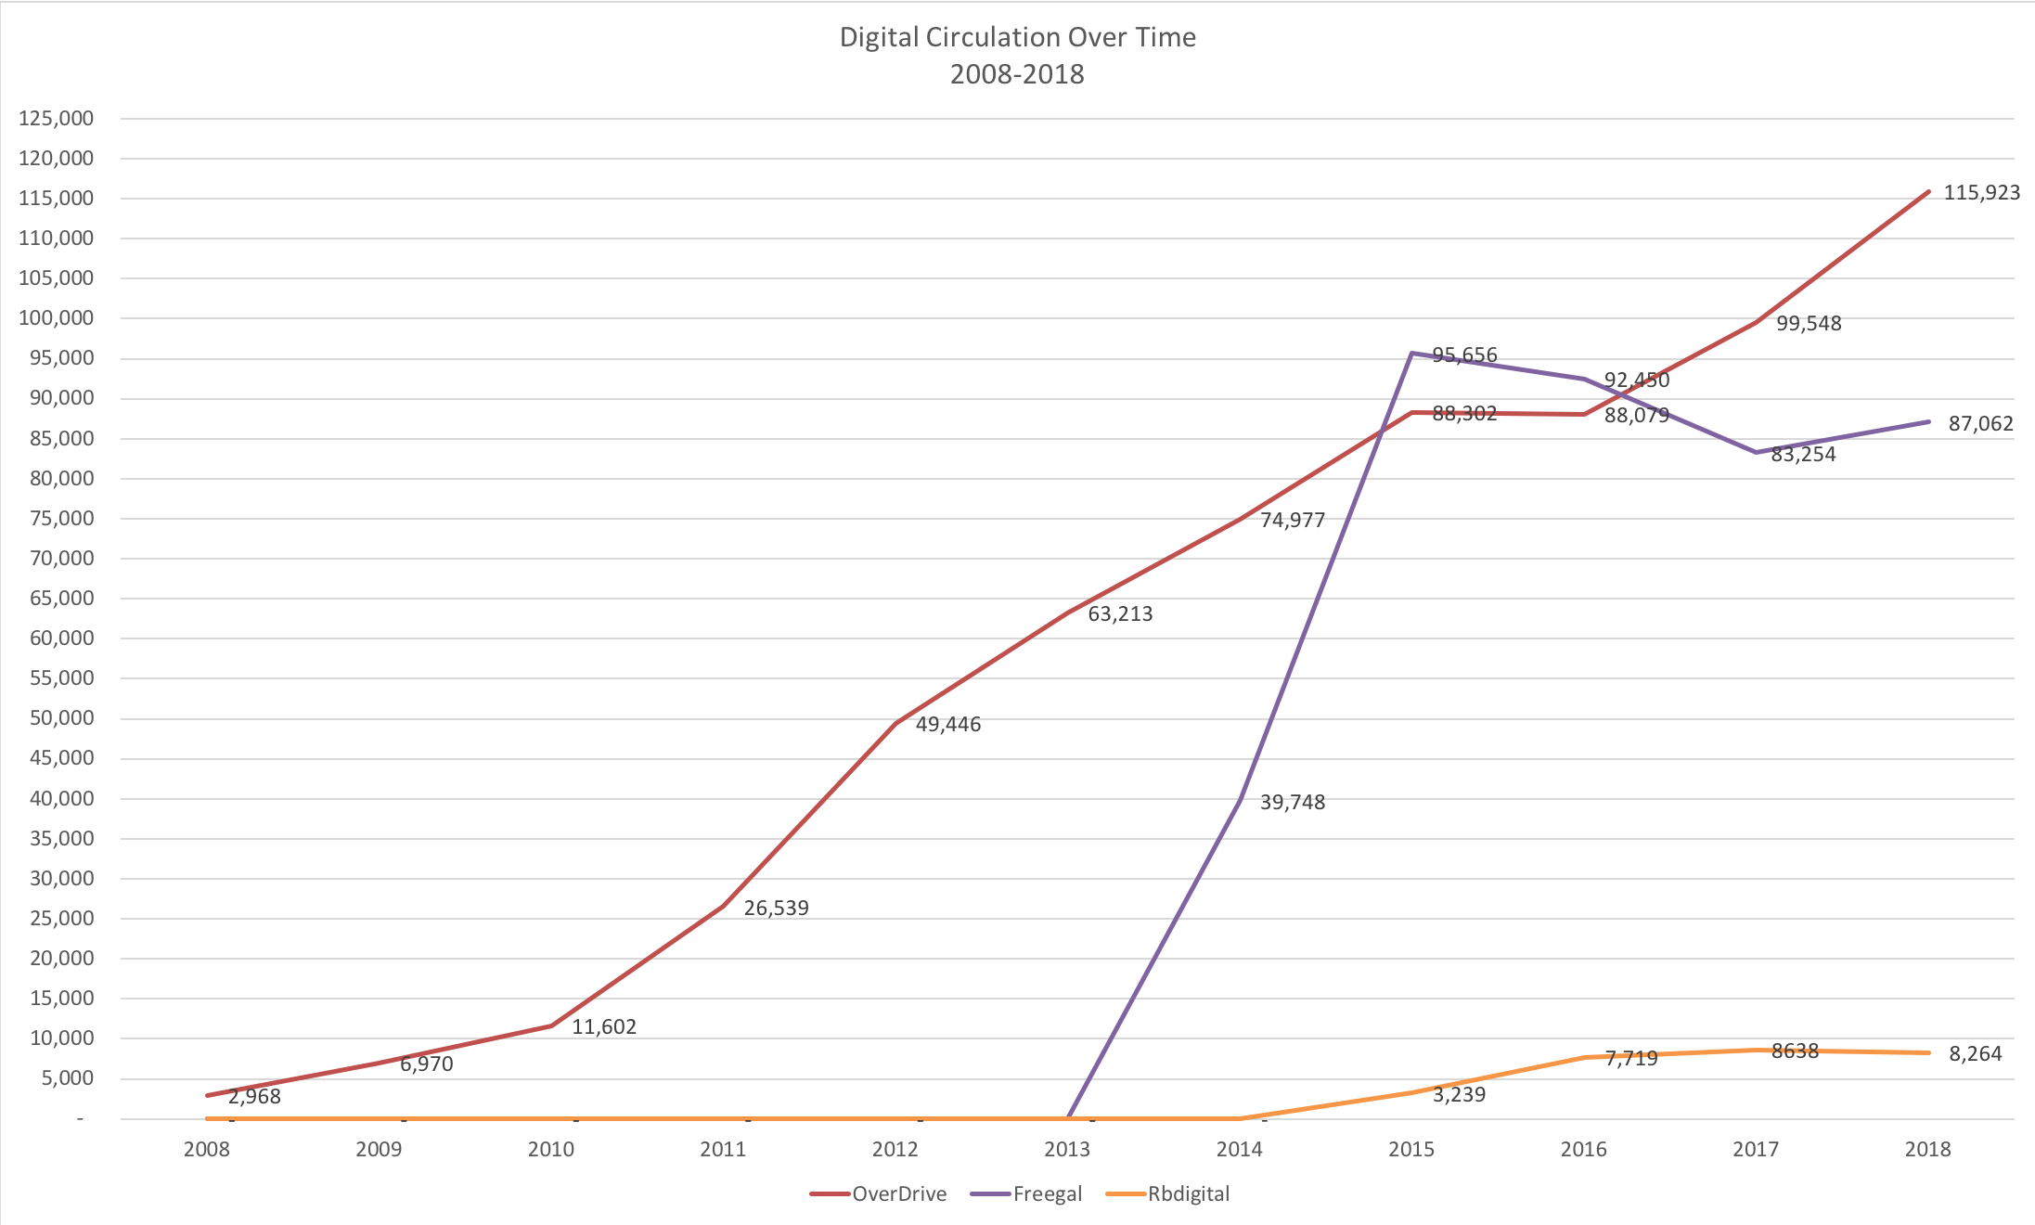
Digital Circulation (2008-2018)
(All platforms: OverDrive, Freegal, RBdigital)
 | OverDrive | Freegal | Rbdigital
2008 | 2,968 | - | -
2009 | 6,970 | - | -
2010 | 11,602 | - | -
2011 | 26,539 | - | -
2012 | 49,446 | - | -
2013 | 63,213 | - | -
2014 | 74,977 | 39,748 | -
2015 | 88,302 | 95,656 | 3,239
2016 | 88,079 | 92,450 | 7,719
2017 | 99,548 | 83,254 | 8638
2018 | 115,923 | 87,062 | 8,264

Slide 4
OverDrive Titles Purchased
(2008 – 2018)
 | Audio | eBook | Video
2008 | 422 | 0 | 0
2009 | 298 | 0 | 0
2010 | 349 | 205 | 0
2011 | 365 | 1508 | 0
2012 | 197 | 2,475 | 148
2013 | 279 | 2209 | 196
2014 | 343 | 2,912 | 270
2015 | 181 | 2,836 | 88
2016 | 317 | 2,693 | 36
2017 | 347 | 2,422 | 47
2018 | 373 | 1,941 | 7

Slide 5
OverDrive Spending
(2008-2018)
 | Audio | eBook | Video
2008 | $ 20,006.68 | $ - | $ -
2009 | $ 12,072.60 | $ - | $ -
2010 | $ 17,180.40 | $ 3,412.38 | $ -
2011 | $ 18,358.16 | $ 23,937.40 | $ -
2012 | $ 11,275.08 | $ 48,603.49 | $ 2,198.75
2013 | $ 14,130.99 | $ 41,492.57 | $ 3,717.25
2014 | $ 20,674.92 | $ 56,748.31 | $ 4,318.87
2015 | $ 12,449.11 | $ 55,946.03 | $ 1,355.66
2016 | $ 19,665.09 | $ 66,924.93 | $ 863.16
2017 | $ 21,375.16 | $ 78,756.33 | $ 1,298.06
2018 | $ 24,793.28 | $ 65,073.38 | $ 98.87

Slide 6
OverDrive Users (2008-2018)
 | 2008 Users | 2009 Users | 2010 Users | 2011 Users | 2012 Users | 2013 Users | 2014 Users | 2015 Users | 2016 Users | 2017 Users | 2018 Users
Total by Year | 533 | 821 | 1190 | 2484 | 3740 | 4146 | 4326 | 4698 | 5062 | 4649 | 5339

Slide 7
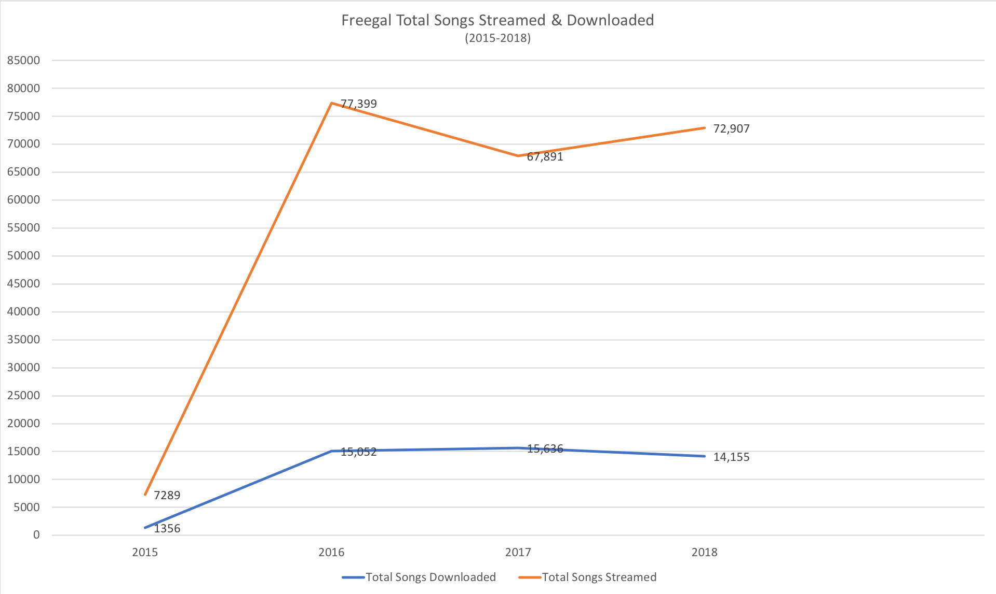
Freegal: Songs Streamed & Downloaded (2015-2018)
Year | Total Songs Downloaded | Total Songs Streamed
2015 | 1356 | 7289
2016 | 15,052 | 77,399
2017 | 15,636 | 67,891
2018 | 14,155 | 72,907

Slide 8
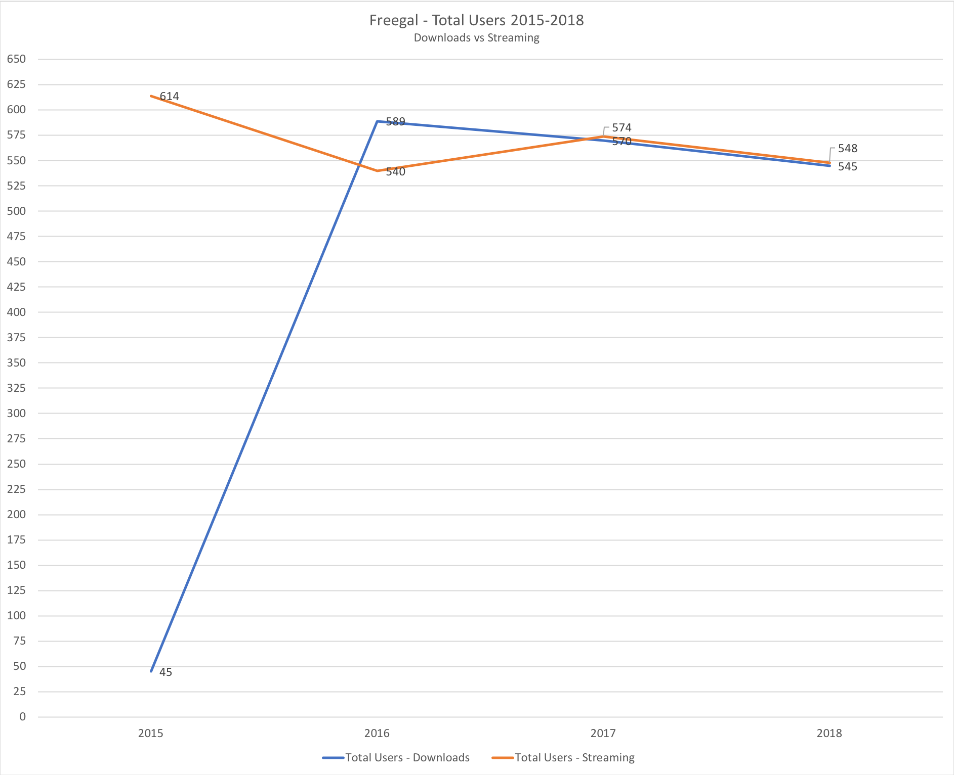
Freegal Users (2015-2018)
 | Total Users - Downloads | Total Users - Streaming
2015 | 45 | 614
2016 | 589 | 540
2017 | 570 | 574
2018 | 545 | 548

Slide 9
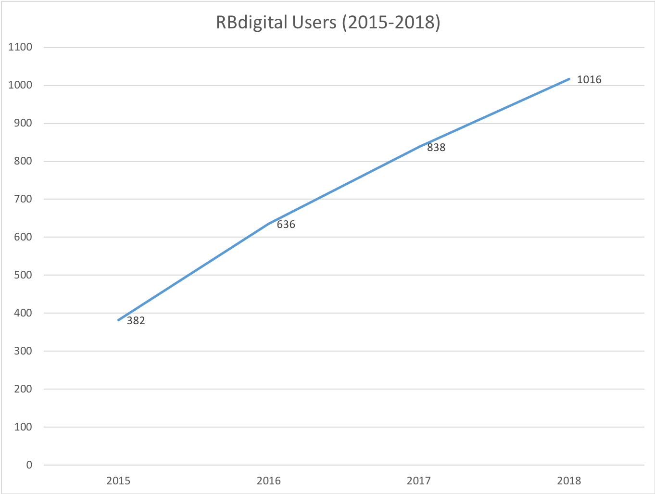
RBdigital Users (2015-2018)
 | Users
2015 | 382
2016 | 636
2017 | 838
2018 | 1016

Slide 10
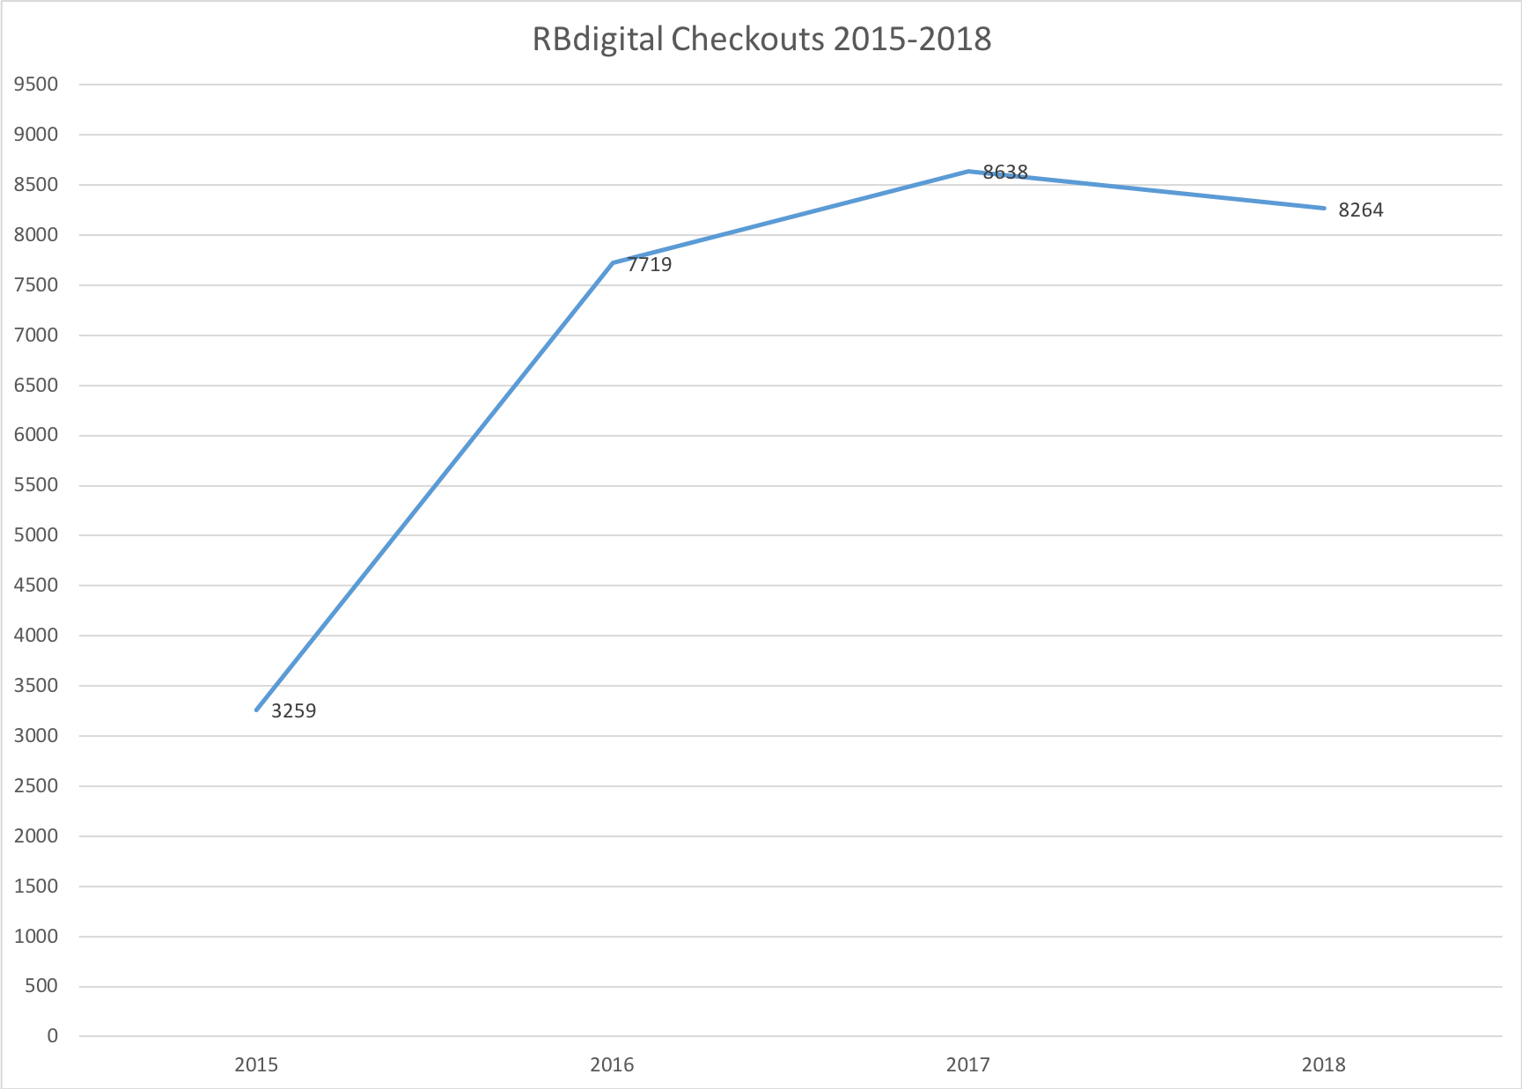
RBdigital Checkouts (2015-2018)
 | Checkouts
2015 | 3259
2016 | 7719
2017 | 8638
2018 | 8264

Slide 11
Platform Comparisons 2018: Cost per Circ & Cost per User
Platform | 2018 Usage (Circ) | 2018 Cost Per Use (Circ) |  | 2018 Total Users | 2018 Cost Per User
Overdrive | 115923 | $ 0.78 |  | 5339 | $ 16.85
Freegal | 86317 | $ 0.41 |  | 548 | $ 63.87
RB Digital | 27320 | $ 0.62 |  | 1016 | $ 16.80

