Slide 1
Tech topics
National Cybersecurity Awareness Month kickoff

Slide 2
NCSAM – Do Your Part. #BeCyberSmart
Now in its 17th year, National Cybersecurity Awareness Month (NCSAM) continues to raise awareness about the importance of cybersecurity across our Nation, ensuring that all Americans have the resources they need to be safer and more secure online.
Let’s celebrate -
All STLS email users will participate in a new KnowBe4 training campaign.

Slide 3
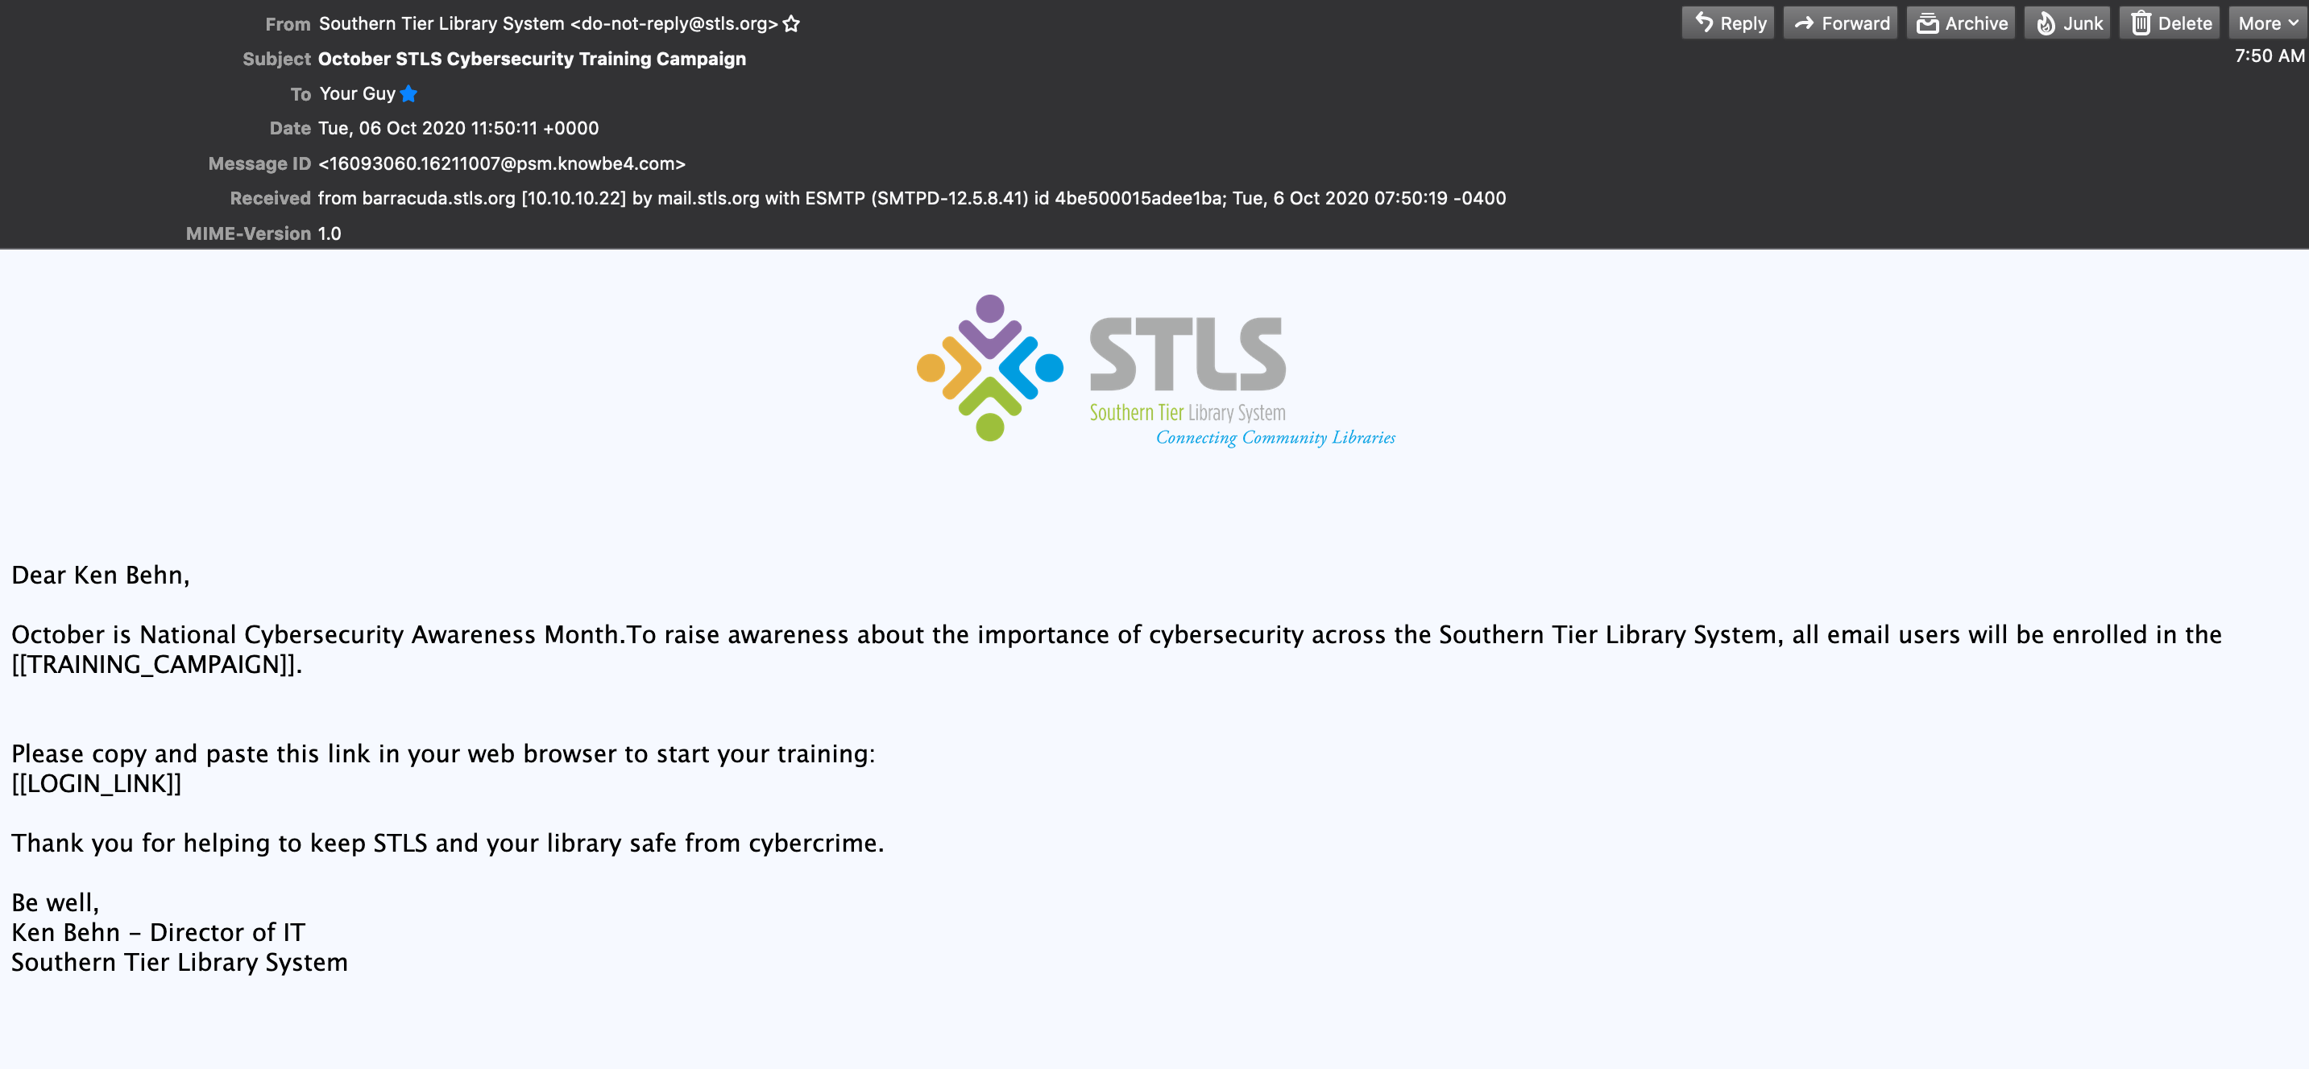
Everyone gets this email

Slide 4
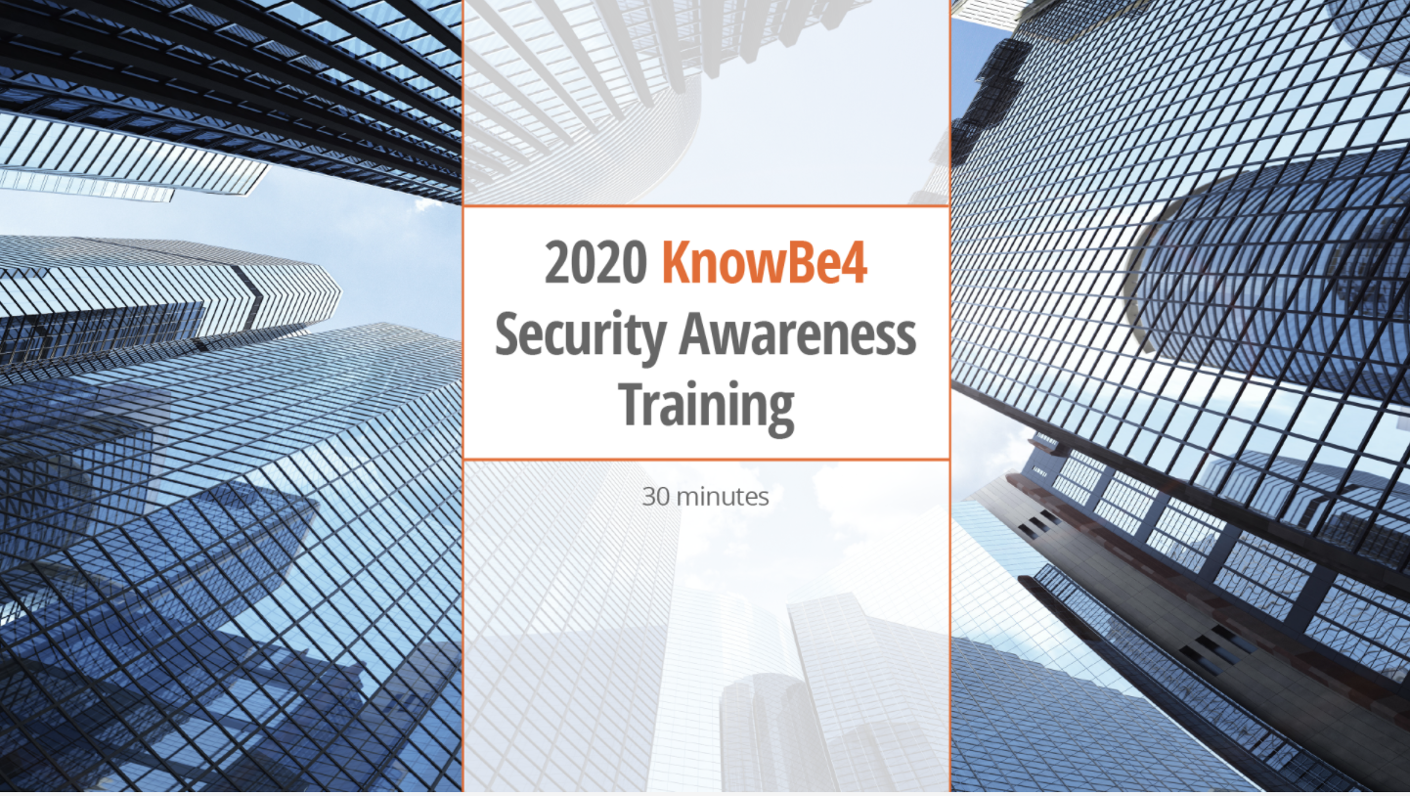

Slide 5
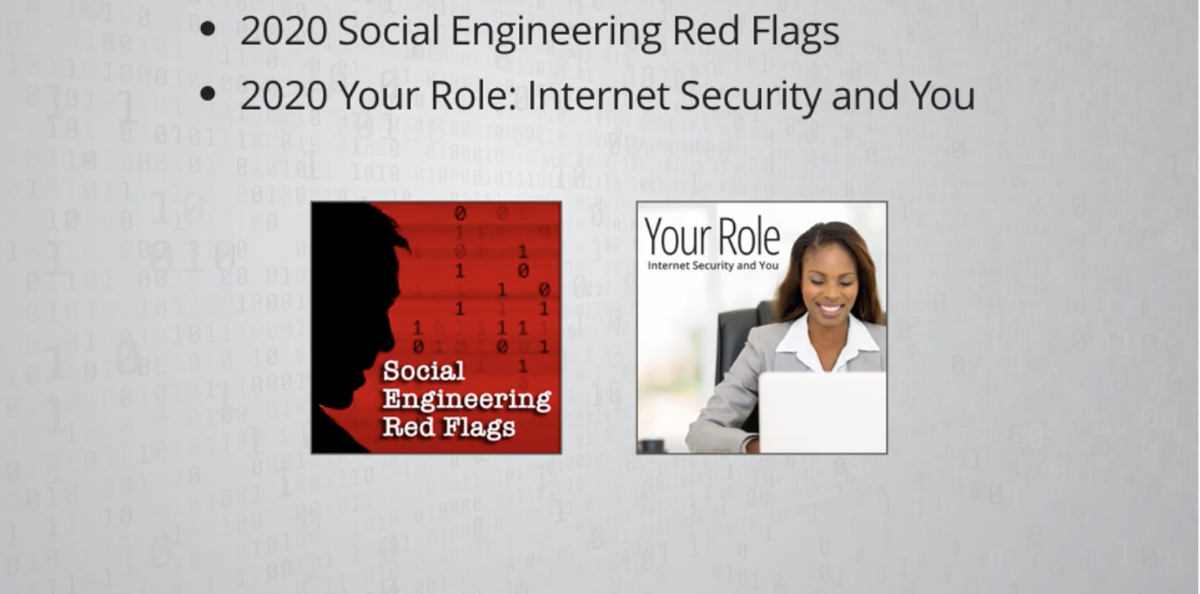
Two main components
Start and stop as often as you need to

Slide 6
Then what?
Reminder messages are automatically be sent each week to email users who haven’t started the training campaign.
Tips sheets and infographics.
Target of 2/3 of users to complete the training by the end of November.
90% would be nice
Remind your staff to watch for an email and participate in the training.
Monthly automated Phish testing still happens.

Slide 7
10 Cybersecurity awareness tips
Don’t click on direct links (in emails, text messages, etc.), especially those that are asking you to enter sensitive information. It's best to go directly to the source.
Don't overshare on social media. These details can provide hackers with your location, ammunition to craft spear phishing attacks, and answers to security questions. Think before you share!
Don’t go “out of bounds” for communication. E.g. if you’re buying something on eBay, and the other party wants to negotiate via email instead of the bidding system.
Never reuse passwords between any website or service.
Always be skeptical of any unexpected invoice, or request to get or pay for anything by using gift cards.

Slide 8
10 Cybersecurity awareness tips
Never answer authentication recovery questions (e.g. What is your mother’s maiden name?) with real answers. Unfortunately, that means you’ll have to write down each question and answer for each website that requires them, but you’ll be far less likely to have your account hijacked.
It is ok to speak to (confirm with) an email sender's request to transfer that $300, by the end of the day, even if it is your boss. Better safe than sorry.
Report any suspicious emails by forwarding them to abuse_notify@stls.org. Do not forward them to anyone else.
Invest in a password management tool – NO one has the time to remember all those passwords!
Be vigilant with suspicious SMS messages. Your bank will NEVER ask you to access your account from an SMS.

Slide 9
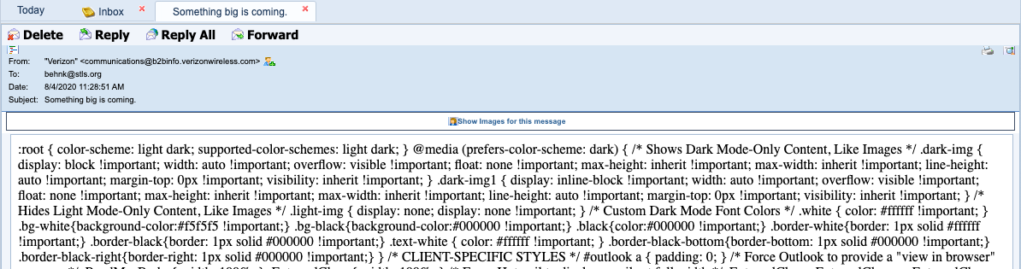
The email header is your friend

Slide 10
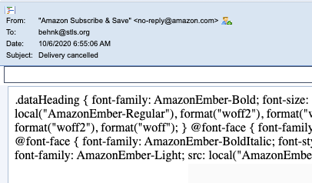
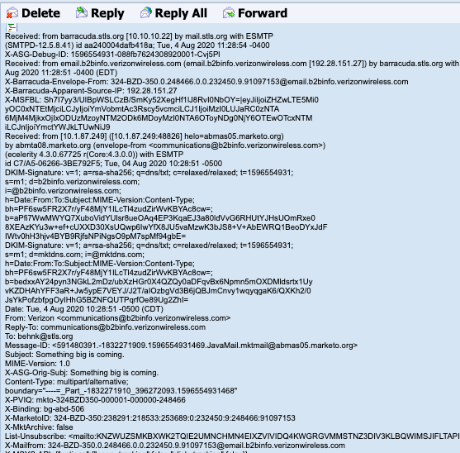
What are you looking for?

Slide 11

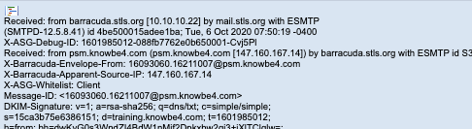
What are you looking for?

Slide 12
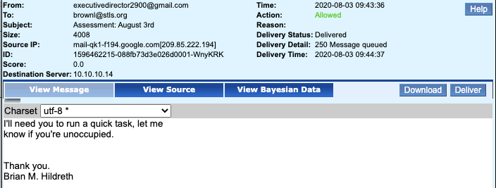

It’s all about phishing email
Every week we get this stuff

Slide 13
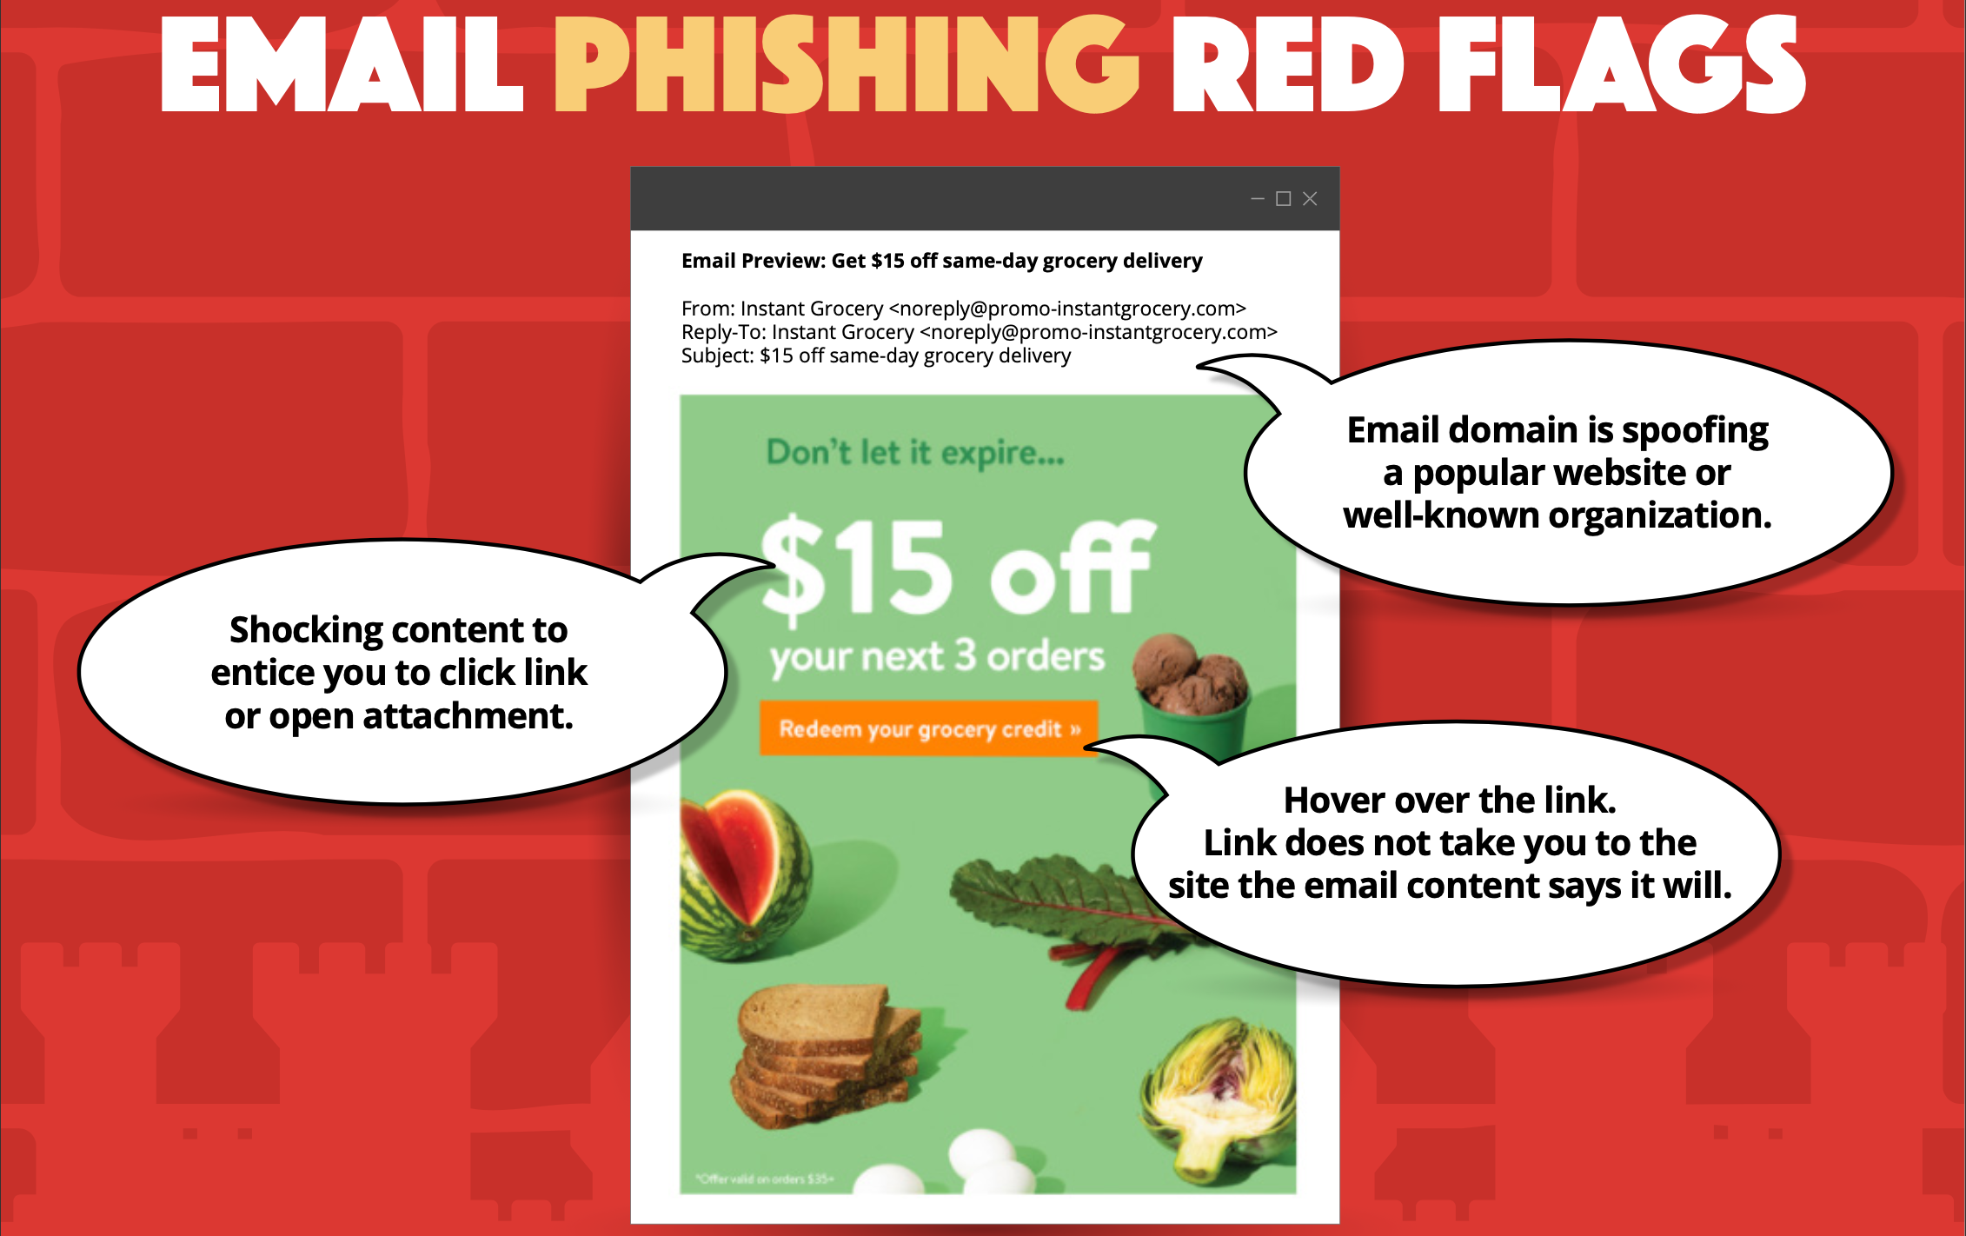

Slide 14
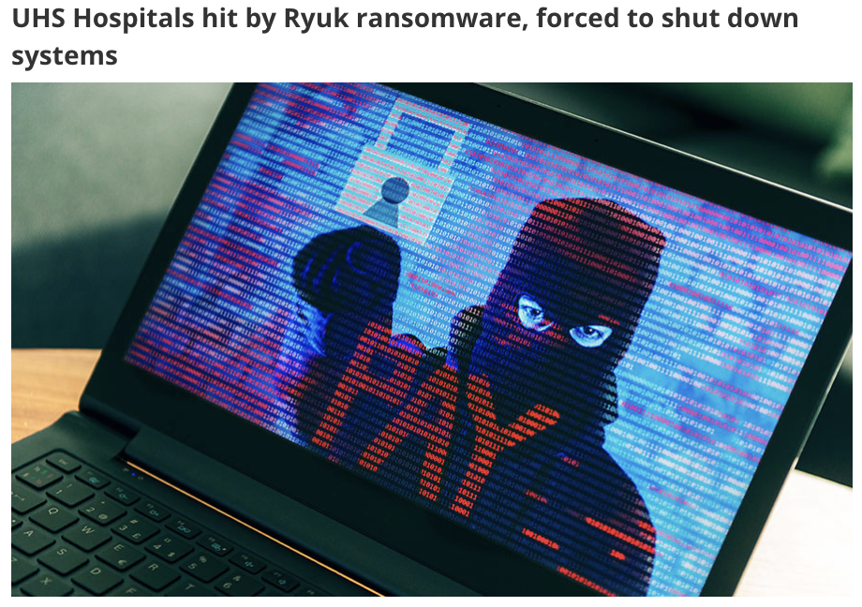
What’s the big deal if I click on a link?

